Slide 1
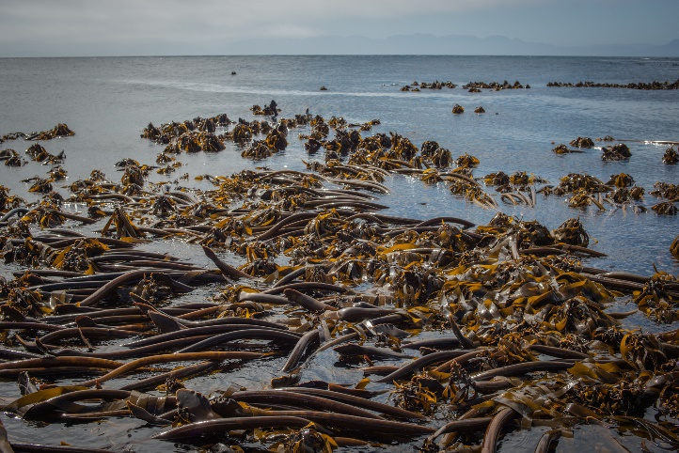

Morphometric properties of shallow water kelp, Ecklonia maxima, along thermal and wave exposure gradients.
Presenter: Jesse Smith
Supervisor: Prof AJ Smit
Co-Supervisor: Ross Coppin
University of the Western Cape
Department of Biodiversity and Conservation Biology
Kelpsandthings.org

Slide 2
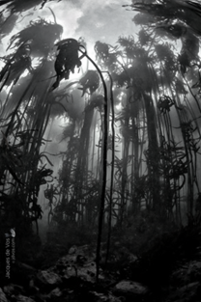
Introduction
Ecklonia maxima is a large brown kelp from the order Laminariales.
Ecologically and economically beneficial.
Thrives in temperate waters in the sub- and intertidal rocky substrate.
Kelp is a keystone species, and one of the most productive ecosystems.
Jdvos.com

Slide 3
Introduction
Kelp beds are influenced by many environmental factors.
Temperature generally controls the geographical distribution of marine organisms.
Important indicator of climate change and elevated sea temperatures.
Interaction of the warm Agulhas and cold Benguela currents.

Slide 4
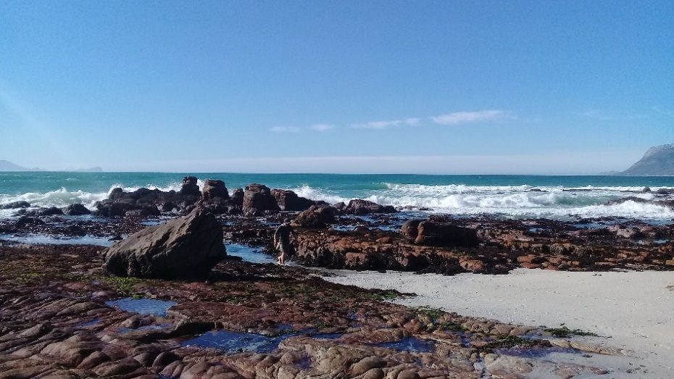
Introduction
Studies show that morphological variables of seaweed can be a function of environmental variables, especially wave action.
Kelp in exposed areas are tougher, sturdier and more strongly attached than those in sheltered areas.
Kelp flexibility as a survival strategy in high water motion environments.

Slide 5
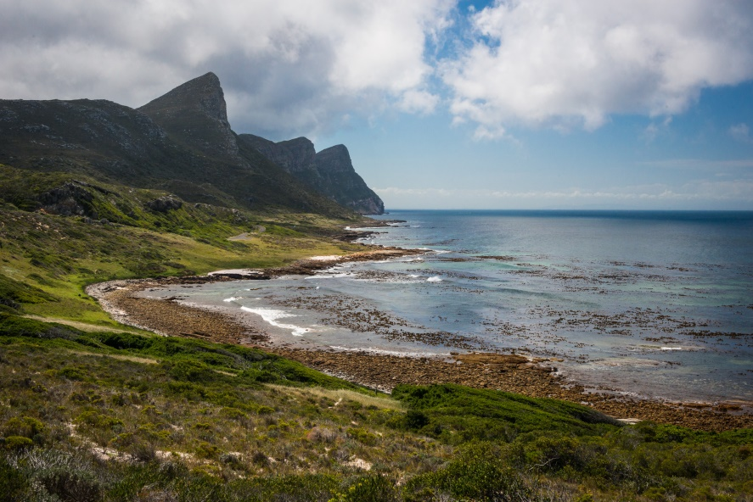
Introduction
Morphological plasticity induced by environmental conditions.
Morphological adaptations to environmental conditions help reduce drag and maximise nutrient uptake.
Sheltered: wide, thin blades with ruffled margins.
Exposed: narrow, thick, flat and smooth blades.
Kelpsandthings.org

Slide 6
Aim & Hypothesis
To quantify the effects of temperature and wave action on the morphology of Ecklonia maxima in shallow water, along the South African coast.
The change in morphology of shallow water Ecklonia maxima is directly related to a gradient in temperature and/or wave action.

Slide 7
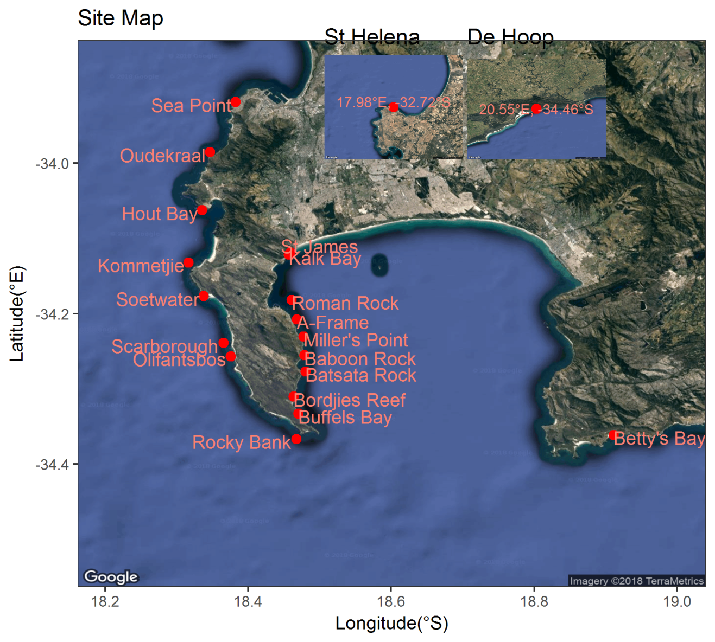
Study Area
20 sites around the south west coast of South Africa.
Combination of sheltered and exposed rocky shores.

Slide 8
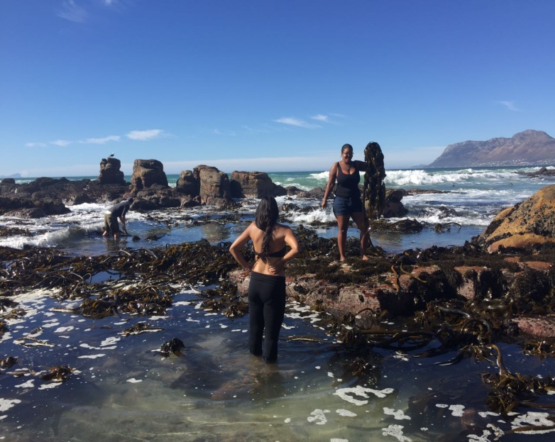
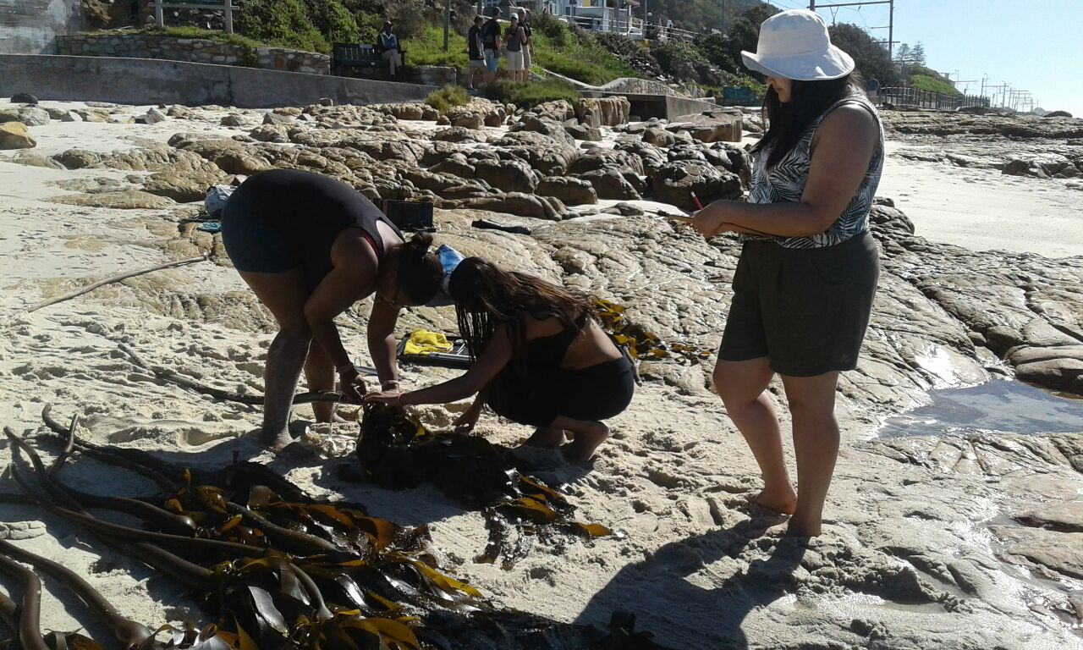
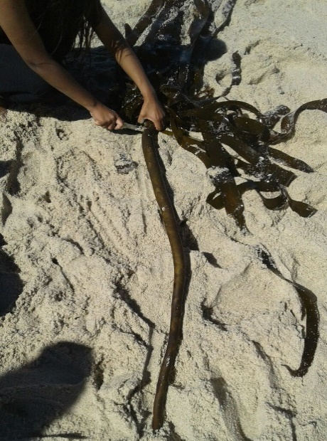
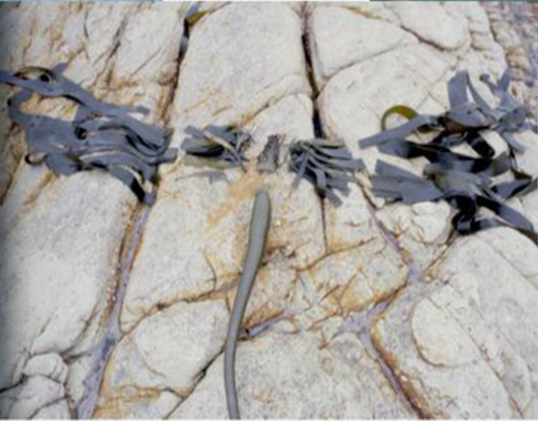
Methods
Morphological variables measured
Primary blade length
Primary blade width
Frond length
Stipe length
Stipe circumference
Number of tufts
Epiphyte length
13 E. maxima individuals collected using snorkel at 1m depth.
Morphological measurements taken and recorded.
Biomass measurements recorded as frond mass and stipe mass.
Notes:
Morphological factors measured: primary blade length, primary blade width, frond length, stipe length, stipe circumference, number of tufts and epiphyte length.

Slide 9
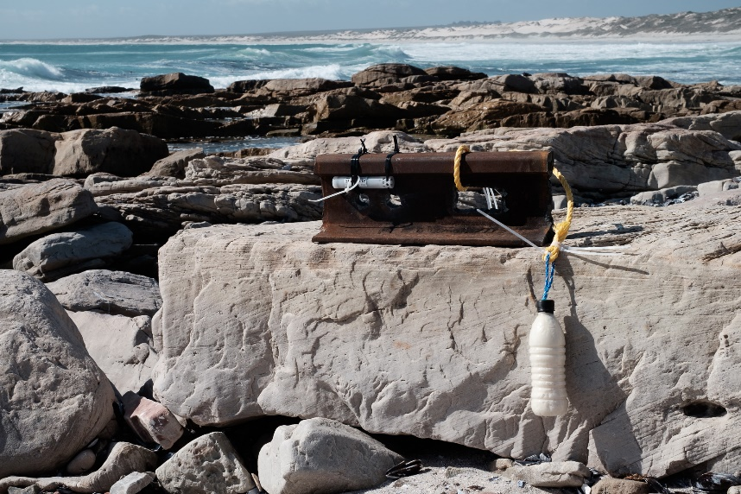
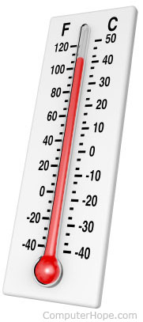
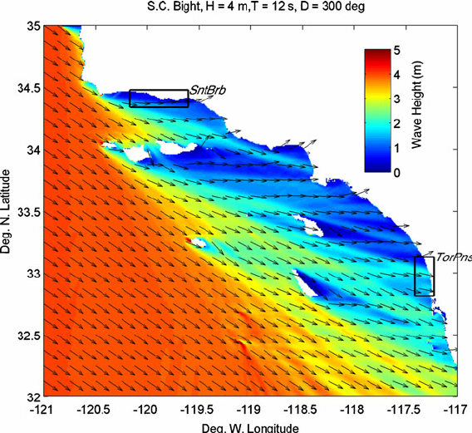
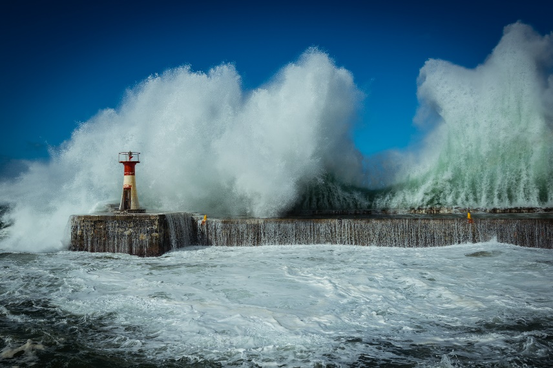
methods
Temperature data obtained from SACTN, using in situ data and UTRs.
Wave data obtained from SAWS, using the SWAN model.
Kelpsandthings.org
Computerhope.com
Adams et al. 2011
Kelpsandthings.org
UTR
In situ
SWAN model
Waves
Notes:
- SWAN = Simulating Waves Nearshore model
A numerical wave model used to obtain realistic estimates of wave parameters in coastal areas, lakes and estuaries from given wind, bottom and current conditions, based on wave action balance equation. (user`s manual, Richard Allard, 2002)

Slide 10

Methods
Statistical analysis done using The R Project for statistical computing and graphics.
Redundancy analyses will be conducted between environmental and morphological variables.
r-project.org

Slide 11
Timeline
Date | Activity
February – April 2018 | Sampling
May – July 2018 | Analysis of Results
August – October 2018 | Write up
October 2018 | First Draft
November 19th 2018 | Final Submission
December 3rd 2018 | Presentation

Slide 12
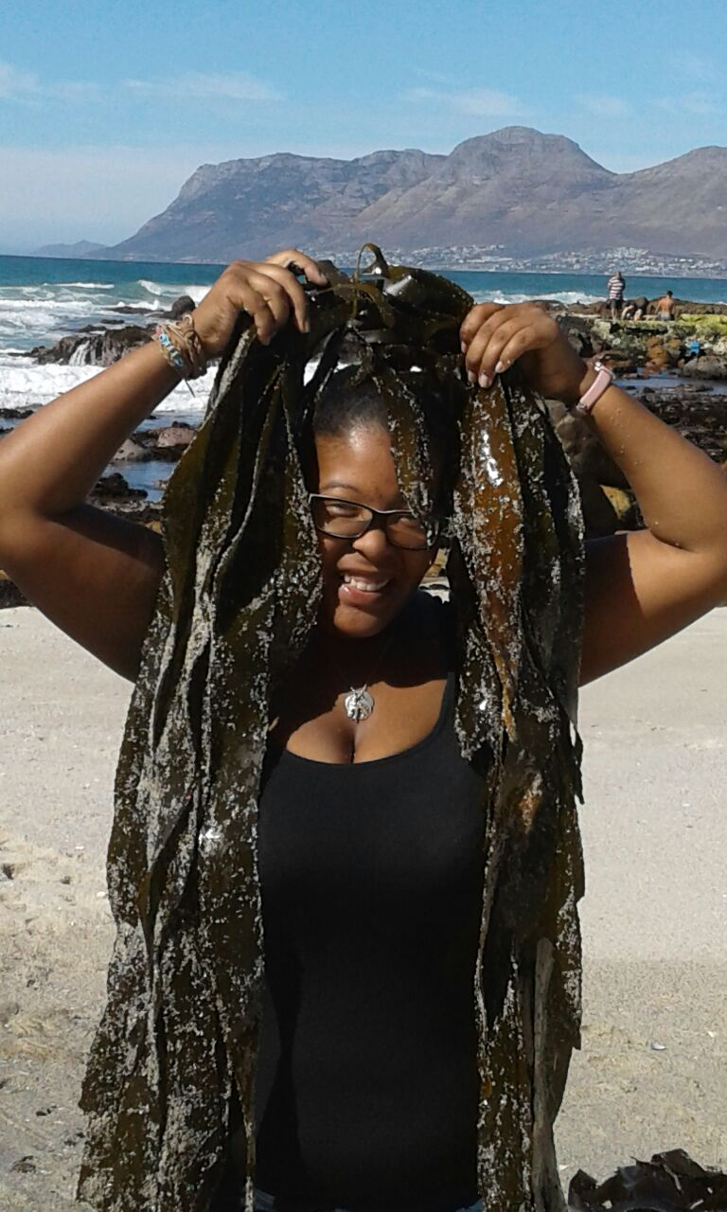
Thank You

